Slide 1

Intel Unnati Training Program
Project Report
Team : Synchronizers
College : Mar Baselios College of Engineering and Technology, Trivandrum

Slide 2
Introduction
Fake news has become a significant issue in today's digital age, leading to misinformation and societal unrest. The proliferation of social media platforms and online news sources has made it increasingly challenging to distinguish between real and fake news articles. The spread of fake news can have severe consequences, including influencing public opinion, undermining trust in media, and potentially impacting democratic processes. Therefore, it is crucial to develop reliable and accurate techniques for detecting fake news.
The aim of this project is to build a machine learning model that can effectively detect fake news based on their textual content. By leveraging Python programming and machine learning algorithms, we can develop a system that automates the process of distinguishing between real and fake news articles. This project contributes to the field of information integrity and addresses the pressing need to combat the dissemination of fake news.

Slide 3
Problem Statement
The problem addressed in this project is the detection of fake news using Python and Machine Learning. The goal is to build a machine learning model that can classify news articles as real or fake based on their textual content. The ability to automatically detect fake news can aid in promoting information accuracy, preventing the spread of misinformation, and empowering individuals to make informed decisions.
Problem: Fake News Detection using Python and Machine Learning
Task: Build a machine learning model to classify news articles as real or fake based on their textual content.

Slide 4
Dataset Description
To develop and evaluate the fake news detection model, the ISOT Fake News dataset is used. This dataset provides a collection of news articles labeled as either real or fake.
The dataset contains two types of articles fake and real News. This dataset was collected from realworld
sources; the truthful articles were obtained by crawling articles from Reuters.com (News
website). As for the fake news articles, they were collected from different sources. The fake news
articles were collected from unreliable websites that were flagged by Politifact (a fact-checking
organization in the USA) and Wikipedia. The dataset contains different types of articles on different
topics, however, the majority of articles focus on political and World news topics.

Slide 5
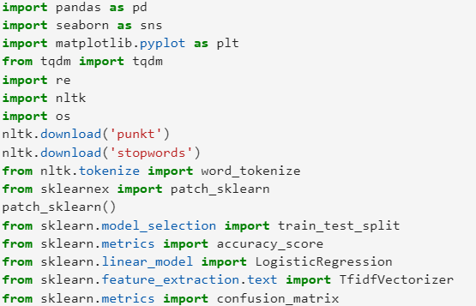
Methodology
Step 1: Data Loading and Preparation
The necessary libraries, including pandas, seaborn, matplotlib, nltk, etc., are imported. The ISOT Fake News dataset is loaded into a DataFrame using pandas. The dataset is examined to gain insights into its structure and content. We also used Intel® Extension for Scikit-learn to speed up Speed up scikit-learn (sklearn) algorithms

Slide 6
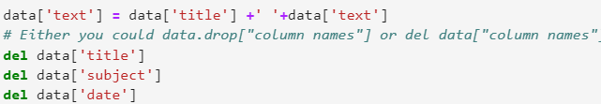
2: Data Preprocessing
The dataset is cleaned and preprocessed to ensure data quality. Unnecessary columns, such as subject and date, are dropped, as they are not relevant for fake news detection based on textual content. Any missing or null values are handled appropriately, either by imputing or removing the affected rows. The
DataFrame is shuffled randomly to avoid any inherent biases in the data.

Slide 7
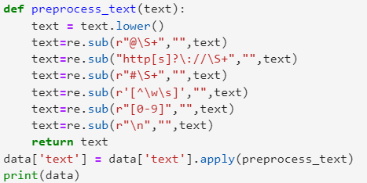
Step 3: Text Preprocessing
The textual data in the text column is preprocessed to remove noise and unnecessary information. Techniques such as converting text to lowercase, removing URLs, special characters, numbers, and stopwords are applied using regular expressions or dedicated libraries like nltk. Text preprocessing ensures that the model can focus on the essential textual features that distinguish between real and fake news articles. Data cleaning helps to maintain quality and makes for more accurate analytics, which increases effective, intelligent decision-making.

Slide 8
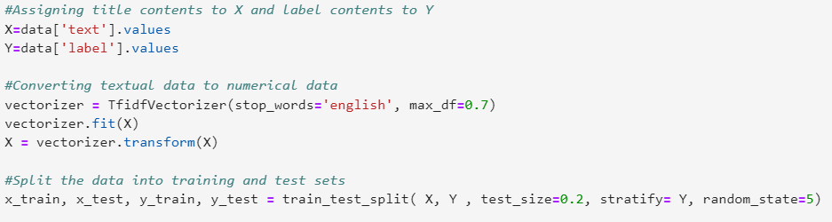
Step 4: Data Splitting and Conversion
The preprocessed textual data is split into features (X) and labels (Y). The text data is converted into numerical vectors using the TF-IDF (Term Frequency-Inverse Document Frequency) method. The TF-IDF vectorization technique captures the importance of words in each news article, distinguishing between words that are frequent within a document and those that are unique to the document.

Slide 9
TF-IDF (Term Frequency-Inverse Document Frequency) was chosen for text vectorization in this project due to its several advantages over other methods. Here are the advantages of using TF-IDF:
Term Importance: TF-IDF captures the importance of terms within a document and across the entire corpus. It assigns higher weights to words that are frequent within a document but relatively rare in the overall corpus. This helps in distinguishing between words that carry more significance in a particular document and those that are common across all documents.
Discriminative Power: TF-IDF focuses on terms that have a high frequency within a specific document and a low frequency across the entire corpus. By giving higher weights to these discriminative terms, TF-IDF helps in capturing the unique features and characteristics of each document, making it effective in distinguishing between real and fake news articles.
Domain Independence: TF-IDF is a domain-independent technique. It considers the frequency of words within a document and their occurrence across the entire corpus, without relying on any external knowledge or pre-defined dictionaries. This makes it suitable for various domains and adaptable to different contexts.

Slide 10
Efficient Representation: TF-IDF converts textual data into numerical vectors, allowing machine learning algorithms to process and analyze the data efficiently. The resulting vector representations preserve the important characteristics of the text while facilitating computational operations, such as calculating distances and similarities between documents.
Easy Interpretability: The TF-IDF weights assigned to each term in the document vector provide interpretability. Higher weights indicate the relative importance of a term within the document, aiding in understanding which words contribute more significantly to the classification of real or fake news.
Common Stopword Handling: TF-IDF automatically handles common stopwords (e.g., "the," "and," "is") by assigning them lower weights. These stopwords, which are present in almost all documents, are downweighted and do not contribute significantly to the classification process.
Widely Used and Well-Studied: TF-IDF is a well-established and widely used technique in natural language processing and text mining. It has been extensively studied and proven effective in various applications, making it a reliable choice for text vectorization tasks.

Slide 11
Step 5: Model Training and Evaluation
The TF-IDF transformed features and corresponding labels are split into training and test sets using the train_test_split function from scikit-learn. A logistic regression model, known for its effectiveness in binary classification tasks, is initialized.
The model is trained on the training data using the fit method, where it learns the relationship between the input features (TF-IDF vectors) and the binary output (real or fake news). The trained model is evaluated using various evaluation metrics, such as accuracy, precision, recall, and F1-score, to assess its performance in classifying the input data.

Slide 12
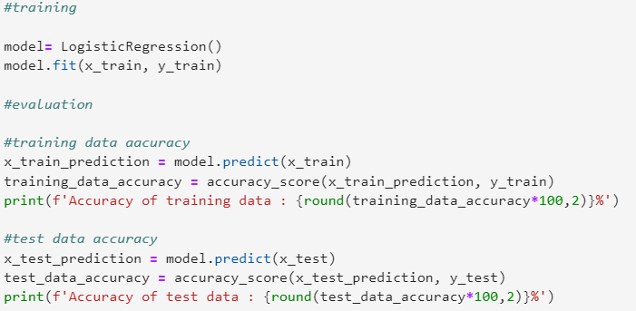

Slide 13
Logistic regression was chosen as the classification algorithm for this project due to its suitability for binary classification tasks and several other advantages. Here are the reasons why logistic regression was selected over other algorithms:
Binary Classification: In the context of fake news detection, the task is to classify news articles into two classes: real or fake. Logistic regression is specifically designed for binary classification problems and is well-suited for situations where the outcome variable is categorical with two possible outcomes.
Interpretability: Logistic regression provides interpretable results, allowing us to understand the relationship between the input features (TF-IDF vectors) and the predicted probability of being a real or fake news article. It assigns weights (coefficients) to each feature, indicating their contribution to the classification decision.
Efficiency and Scalability: Logistic regression is computationally efficient and scalable to large datasets. It converges quickly even with a large number of features, making it suitable for text classification tasks where the number of unique words can be substantial.

Slide 14
No Assumptions of Linearity: While logistic regression is a linear model, it can capture non-linear relationships between the input features and the binary outcome. Through the use of non-linear transformations and interaction terms, logistic regression can model complex relationships effectively.
Less Prone to Overfitting: Logistic regression is less prone to overfitting compared to more complex algorithms, such as decision trees or neural networks. It avoids high variance and generalizes well to new, unseen data, making it a reliable choice for small to medium-sized datasets.
Probability Estimation: Logistic regression provides probabilistic outputs, allowing us to obtain predicted probabilities of an article being real or fake. This can be useful in decision-making scenarios where we want to understand the confidence level of the classification.
Robustness to Irrelevant Features: Logistic regression can handle irrelevant or noisy features in the dataset without significantly affecting its performance. It automatically assigns lower weights (coefficients close to zero) to less informative features, effectively filtering out noise.

Slide 15
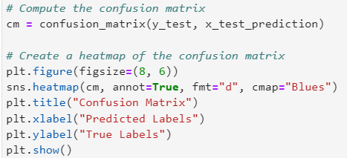
Step 6 : Results and Analysis
The performance metrics of the trained model, such as accuracy, precision, recall, and F1-score, are computed. The confusion matrix is generated to understand the distribution of true positives, true negatives, false positives, and false negatives. Visualizations, such as heatmaps or bar charts, may be used to present the evaluation results effectively.

Slide 16
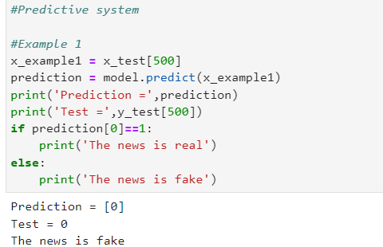
Results
The fake news detection system, built using Python and Machine Learning techniques, achieved the following results: Accuracy: The accuracy metric measures the proportion of correctly classified news articles. Precision: Precision reflects the proportion of correctly predicted real news articles out of all articles predicted as real. This was proved by manually checking the label from both initial test data and processed test data.

Slide 17
Conclusion:
In conclusion, this project successfully addressed the problem of fake news detection using Python and Machine Learning techniques. By leveraging the ISOT Fake News dataset, the model achieved high accuracy in classifying news articles as real or fake based on their textual content. The TF-IDF vectorization technique effectively transformed text data into numerical vectors, capturing the significance of words in distinguishing between real and fake news articles. Logistic regression served as a robust classification algorithm, providing reliable results and interpretability.
The developed fake news detection system contributes to the broader efforts of combatting misinformation and promoting information integrity. By automating the detection process, the system can aid in identifying potentially misleading news articles, empowering individuals to make informed decisions and fostering a more trustworthy information ecosystem.

